Slide 1
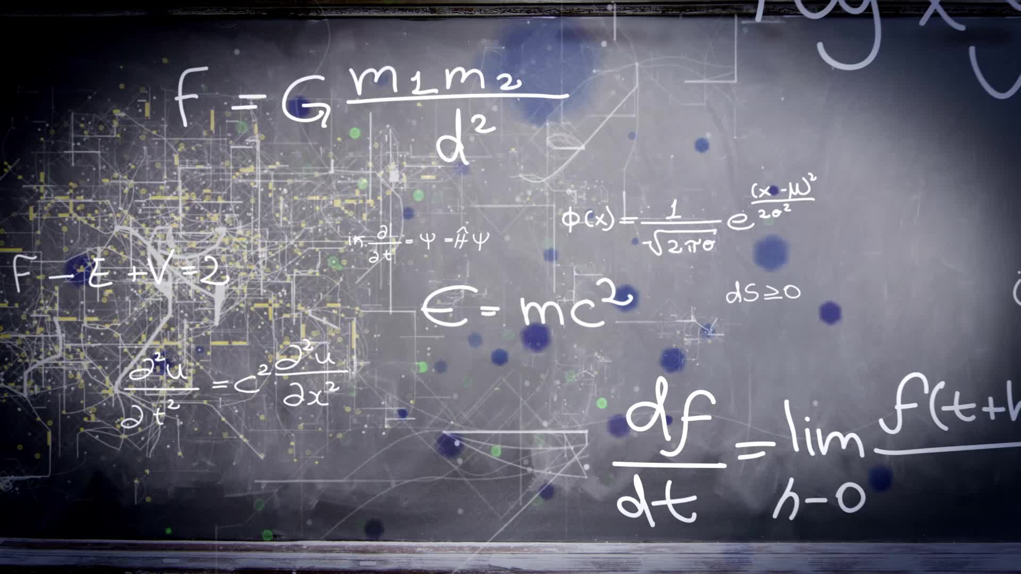
Chapter 1.3:
Evaluating Limits Analytically
HONORS CALCULUS/CALCULUS

Slide 2
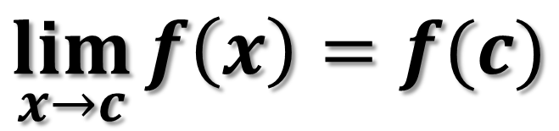
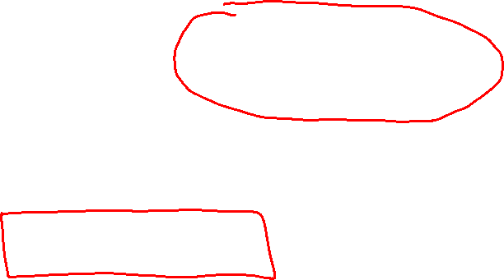
Properties of Limits
The limit of f (x) as x approaches c does not depend on the value of f at x = c.
However, the limit could be precisely f (c).
In such cases, the limit can be evaluated by direct substitution. That is,
Such well-behaved functions are continuous at c.
$$\lim_{x→c}{f\left(x\right)=f(c)}$$

Slide 3
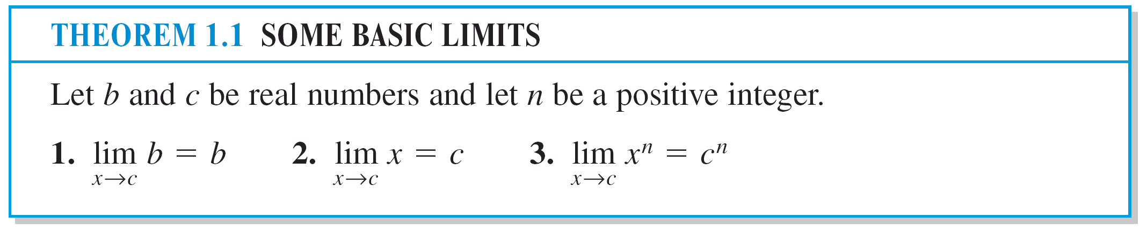
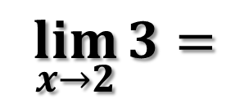
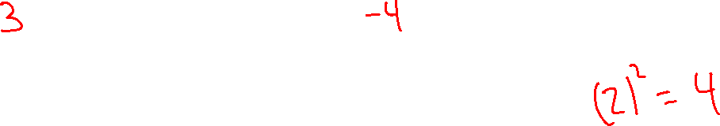
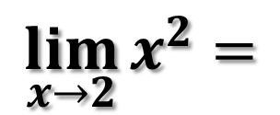
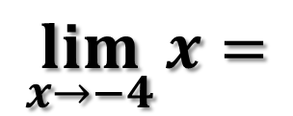
Ex. 1)
$$\lim_{x→2}{3=}$$
$$\lim_{x→−4}{x=}$$
$$\lim_{x→2}{x^{2}=}$$

Slide 4
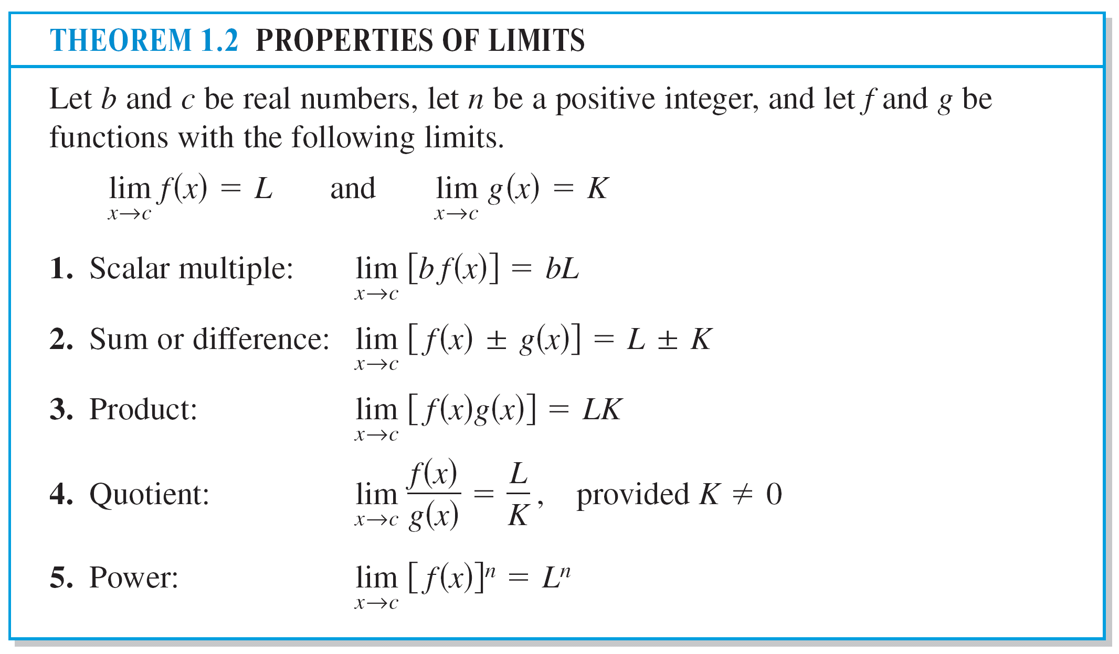

Slide 5
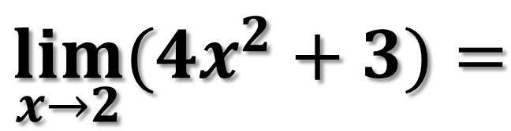
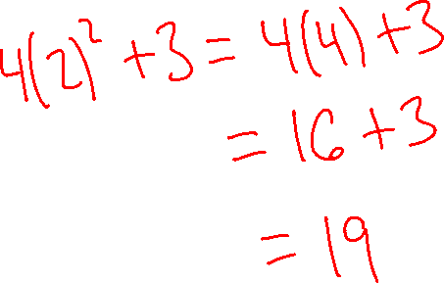
Ex. 2)
$$\lim_{x→2}{(4x^{2}+3)=}$$

Slide 6
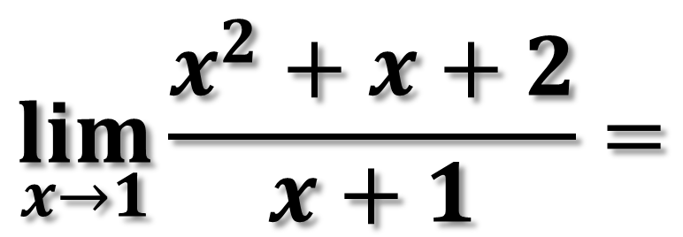
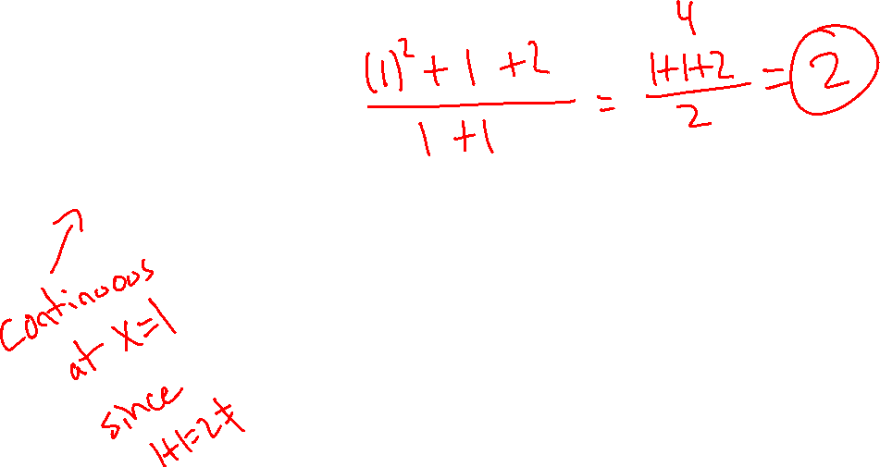
Ex. 3)
$$\lim_{x→1}{\frac{x^{2}+x+2}{x+1}=}$$

Slide 7
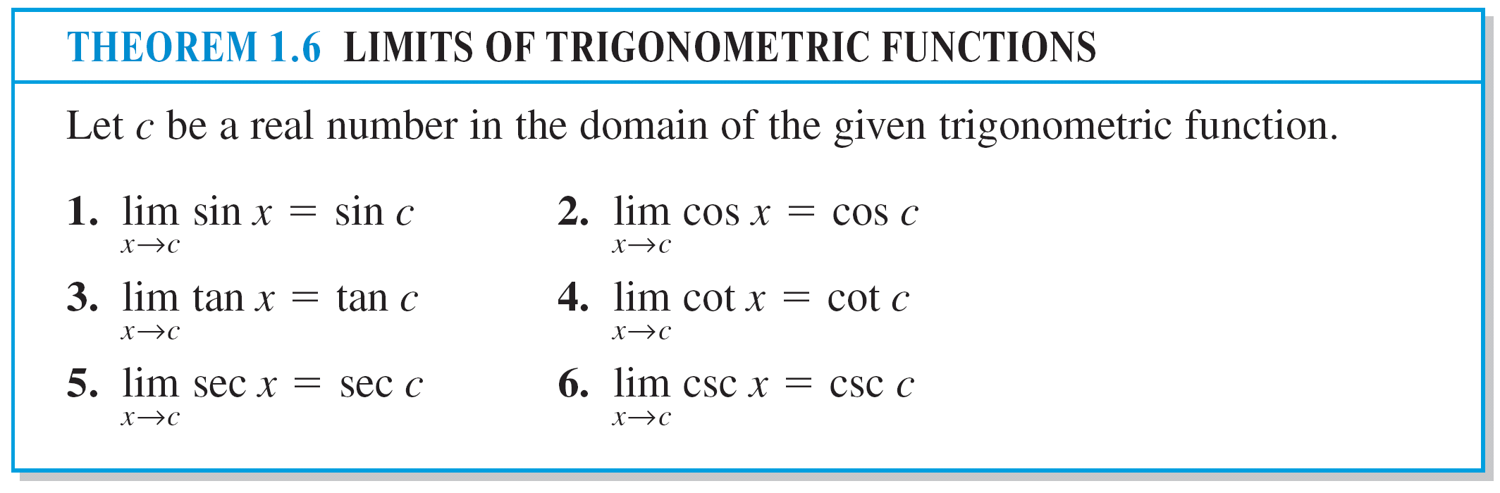
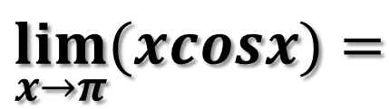
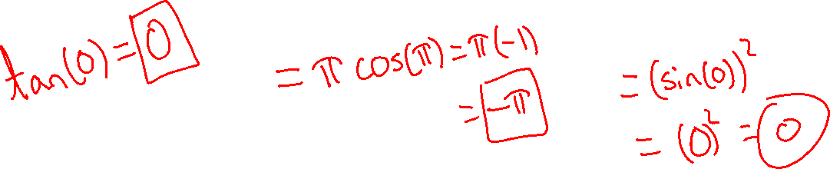
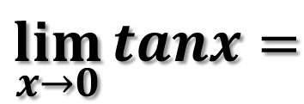
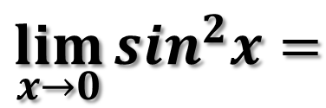
Ex. 4)
$$\lim_{x→0}{tanx=}$$
$$\lim_{x→π}{(xcosx)=}$$
$$\lim_{x→0}{\sin^{2}x=}$$

Slide 8
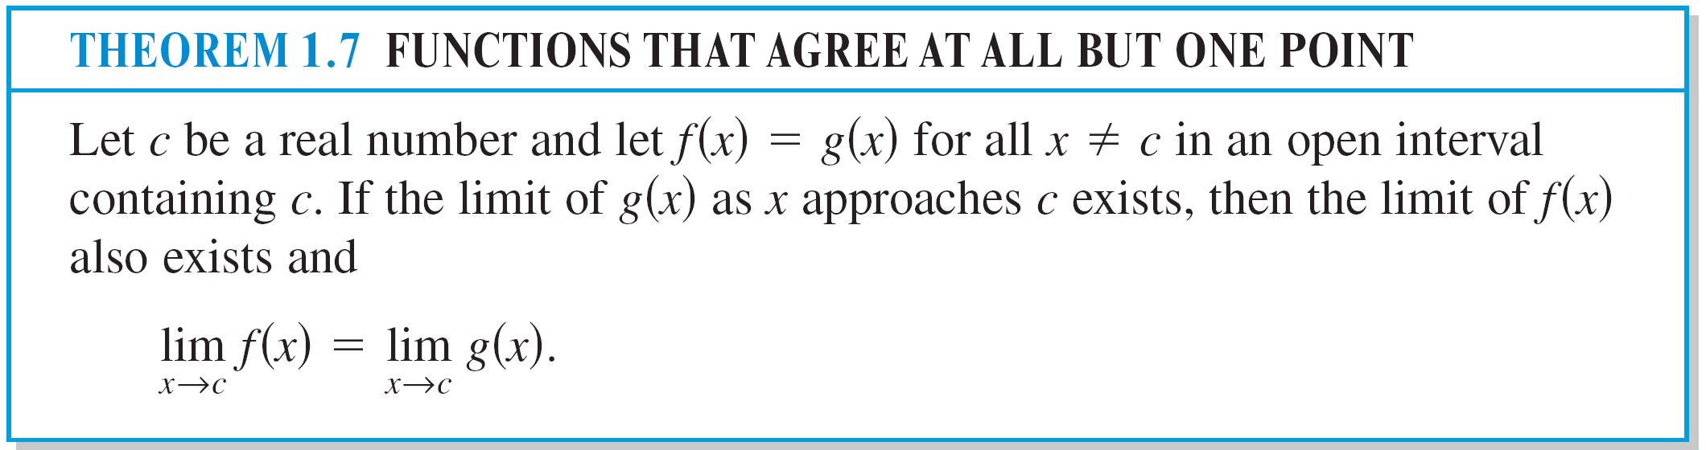
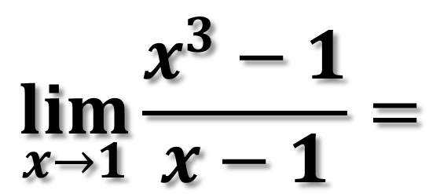
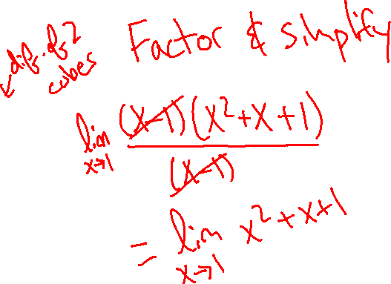
Ex. 5)
$$\lim_{x→1}{\frac{x^{3}−1}{x−1}=}$$

Slide 9
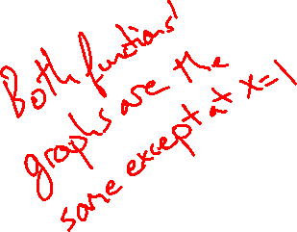
Ex. 5)

Slide 10
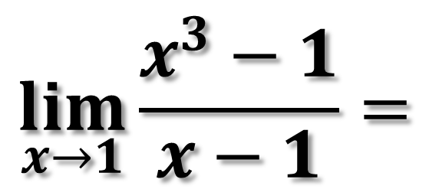
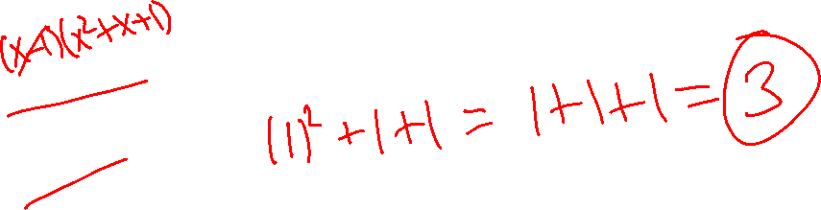
Ex. 5)
$$\lim_{x→1}{\frac{x^{3}−1}{x−1}=}$$

Slide 11
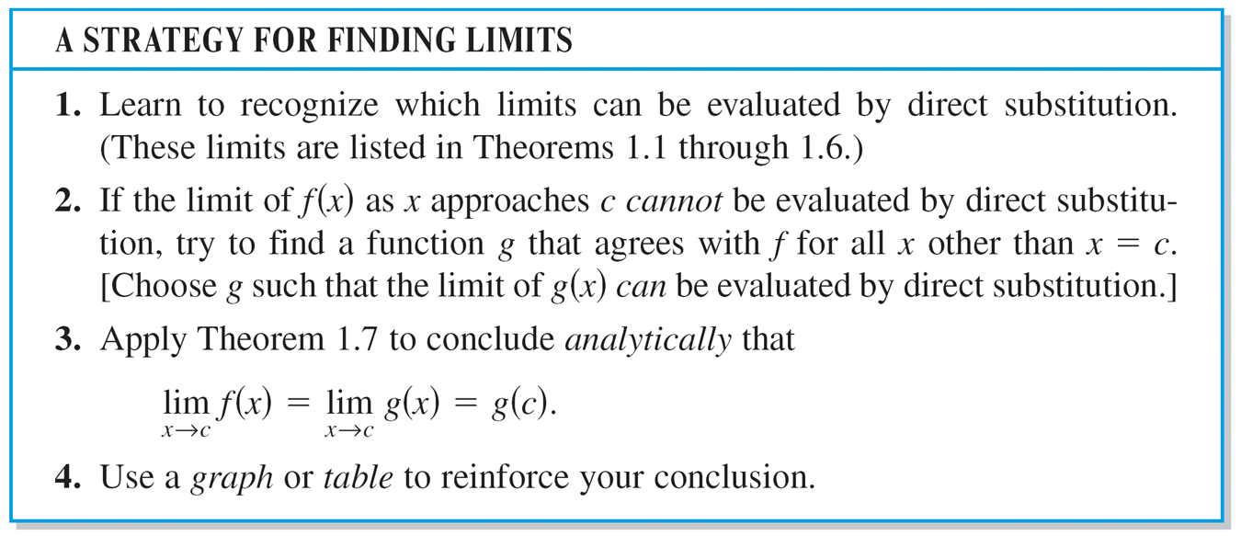

Slide 12
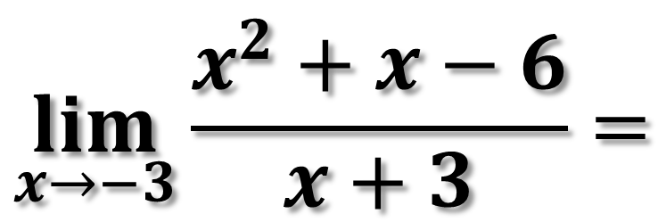
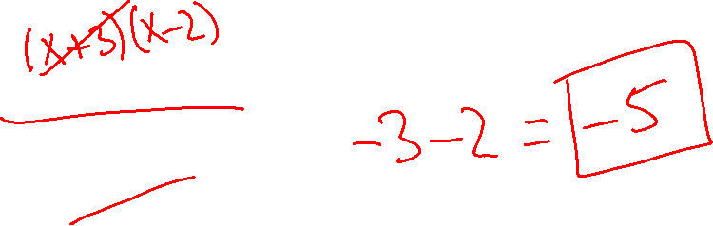
DIVIDING OUT TECHNIQUE
Ex. 6)
$$\lim_{x→−3}{\frac{x^{2}+x−6}{x+3}=}$$

Slide 13
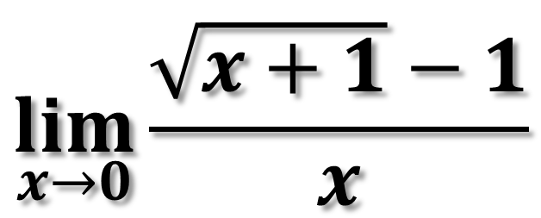
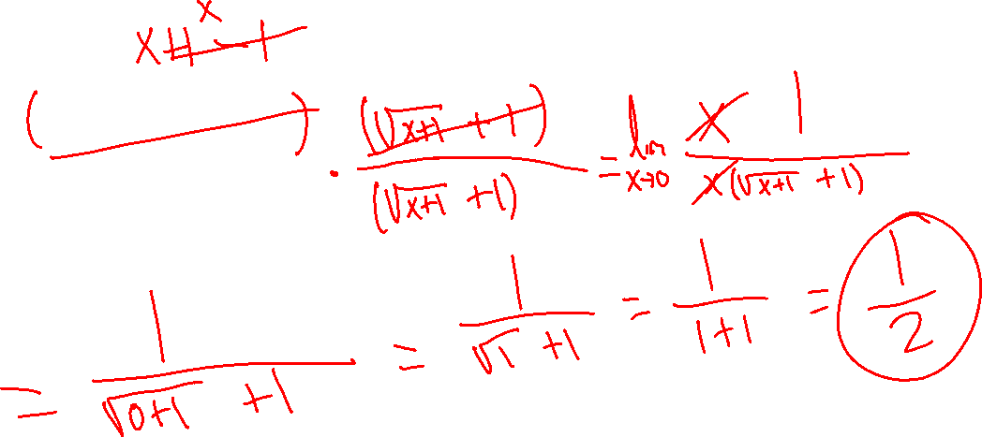
RATIONALIZING TECHNIQUE
Ex. 7)
$$\lim_{x→0}{\frac{\sqrt{x+1}−1}{x}}$$

Slide 14
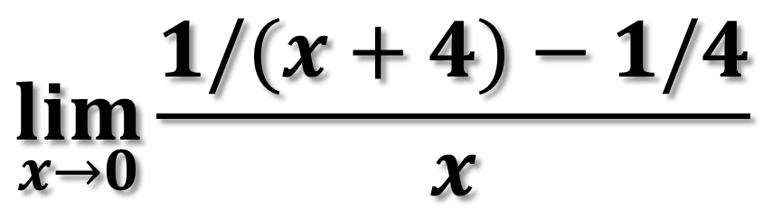
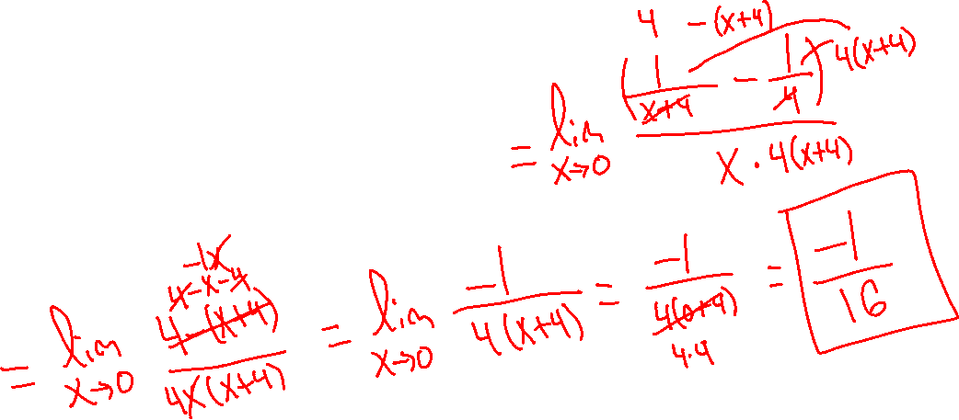
RATIONALIZING TECHNIQUE
Ex. 8)
$$\lim_{x→0}{\frac{1/(x+4)−1/4}{x}}$$

Slide 15
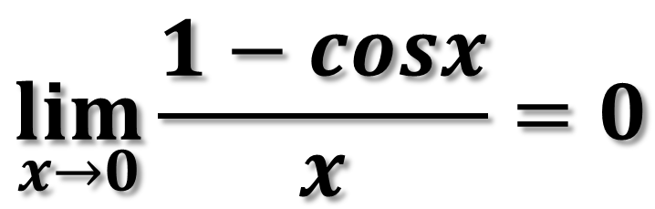
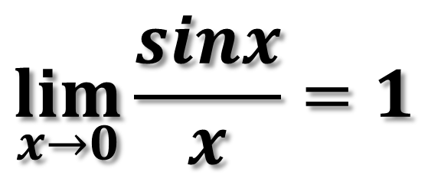
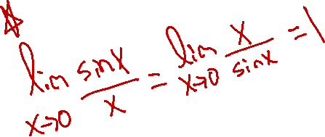
THE SQUEEZE THEOREM
THEOREM 1.9: TWO SPECIAL TRIGONOMETRIC LIMITS
$$\lim_{x→0}{\frac{sinx}{x}=1}$$
$$\lim_{x→0}{\frac{1−cosx}{x}=0}$$

Slide 16
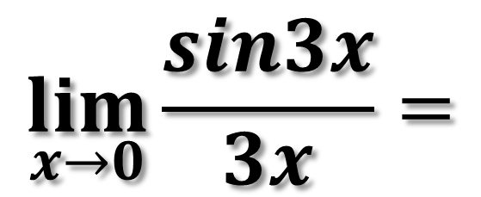
Ex. 9)
$$\lim_{x→0}{\frac{sin3x}{3x}=}$$

Slide 17
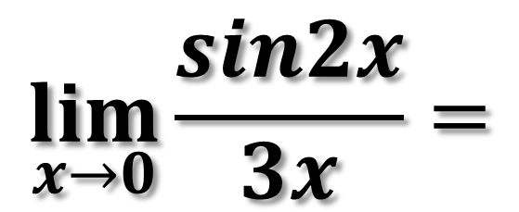
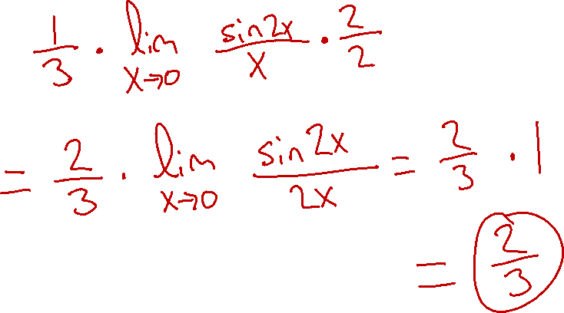
Ex. 10)
$$\lim_{x→0}{\frac{sin2x}{3x}=}$$

Slide 18
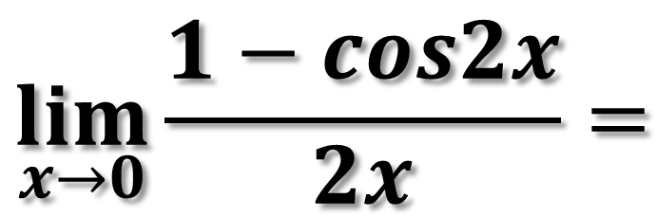

Ex. 11)
$$\lim_{x→0}{\frac{1−cos2x}{2x}=}$$

Slide 19
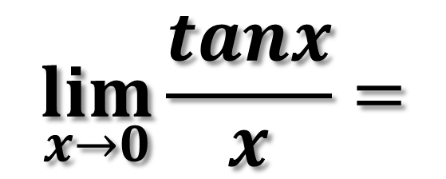
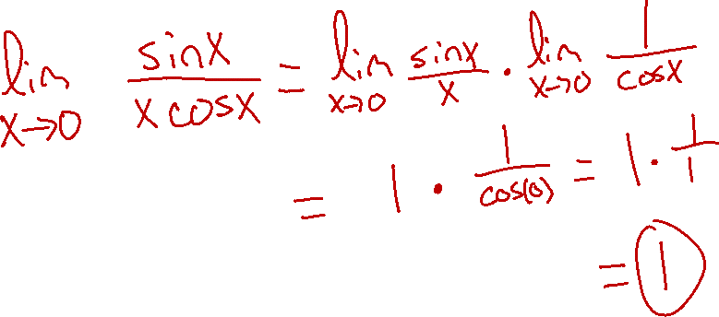
Ex. 12)
$$\lim_{x→0}{\frac{tanx}{x}=}$$

Slide 20
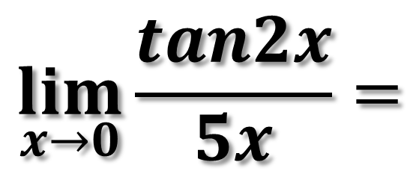
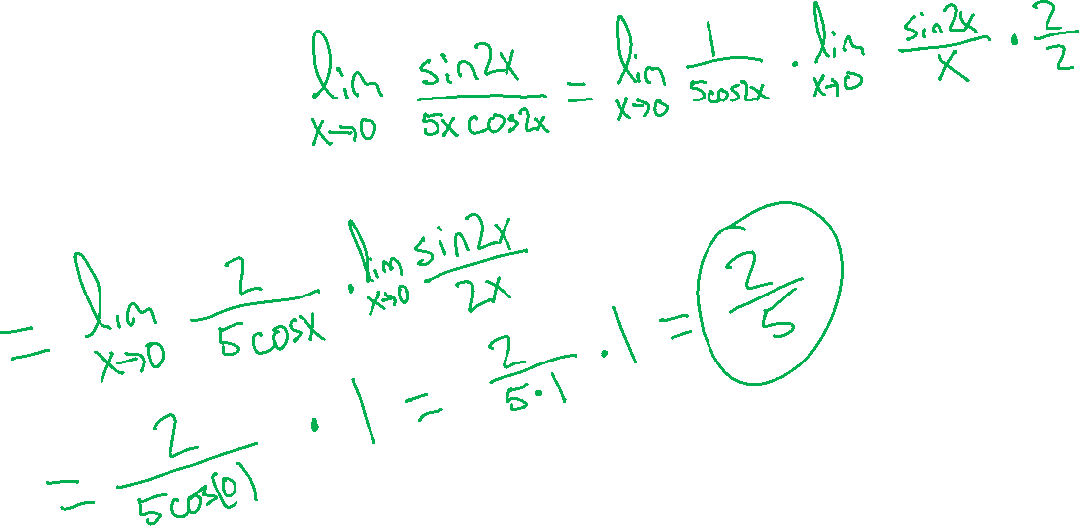
Ex. 13)
$$\lim_{x→0}{\frac{tan2x}{5x}=}$$

